Slide 1

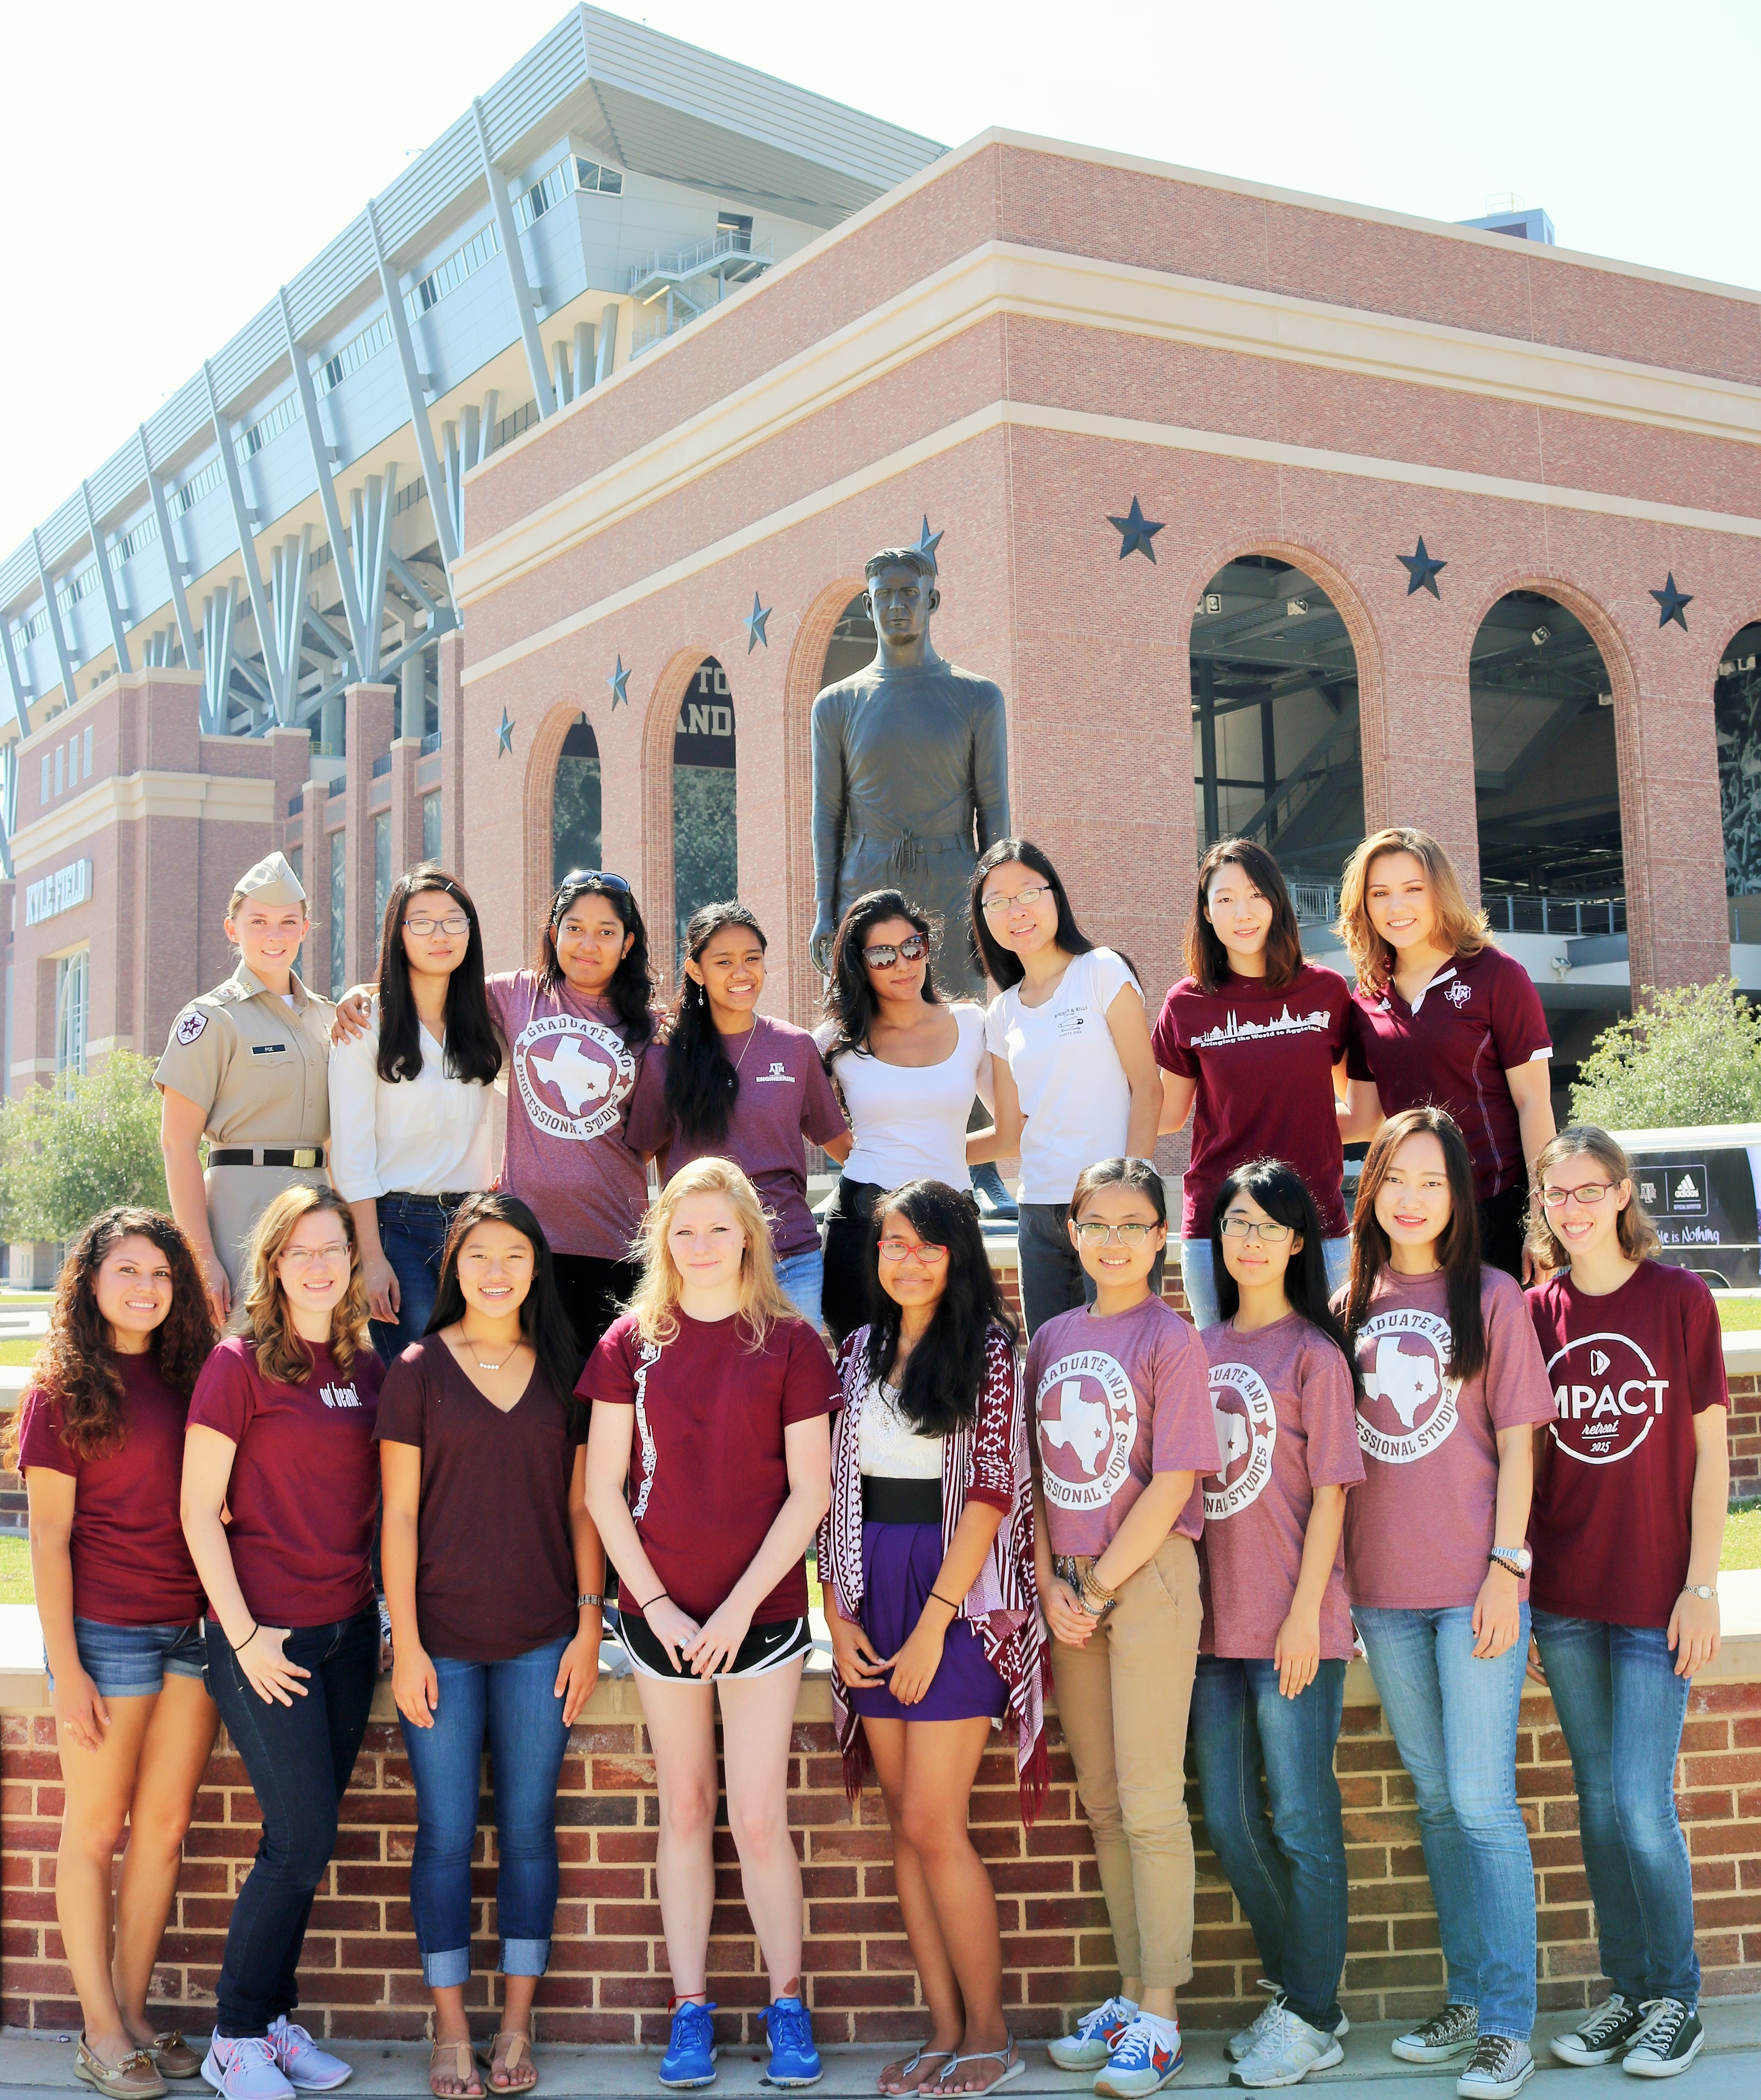
Let’s Chat: Women in Engineering
Employee Engagement Series
January 27, 2017
Shawna Fletcher, MS BME
Director

Slide 2
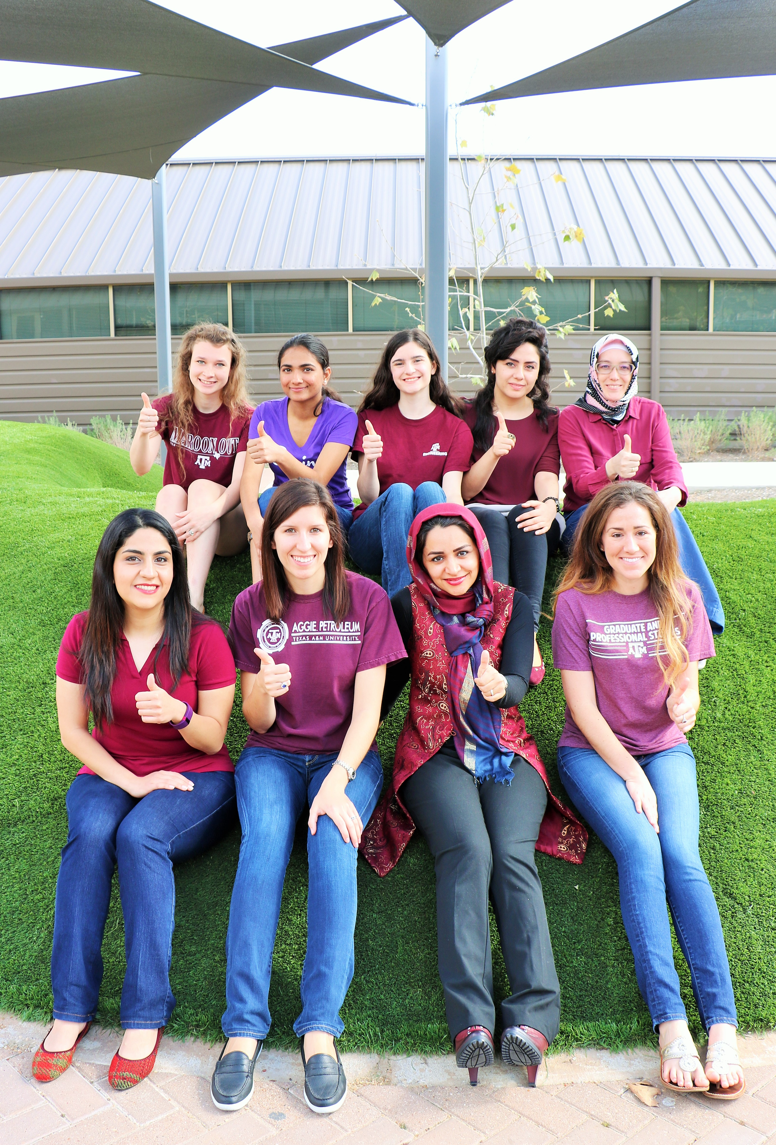
Women in Engineering Program
COE Strategic Plan
→ 4 Focus Areas
Transformation of Undergraduate Engineering Education
Develop a World-Class Research Portfolio
Graduate Program Excellence with World-Class Research
Faculty Development
https://tx.ag/weprogram
*Calendar of Events!
weoutreach@tamu.edu

Slide 3
Women in Engineering Program
22.1%
*Includes CS campus & Academies only
DARS Data Dashboard, Certified Data 2016, College Station Campus only, accountability.tamu.edu
Massey, J., COE Certified Data 2016, College Station Campus and Academies only
Yoder, B., American Society for Engineering Education, Engineering by the Numbers Report, 2014

Slide 4
Women in Engineering Program
DARS Data Dashboard, Certified Data 2015, College Station Campus only, accountability.tamu.edu

Slide 5
Women in Engineering Program
DARS Data Dashboard, Certified Data 2016, College Station Campus only, accountability.tamu.edu
Massey, James – COE Certified Data 2016, College Station Campus and Academies only
Yoder, B., American Society for Engineering Education, Engineering by the Numbers Report, 2014

Slide 6
Women in Engineering Program
DARS Data Dashboard, Certified Data 2016, College Station Campus only, accountability.tamu.edu
Massey, James – COE Certified Data 2016, College Station Campus and Academies only
Yoder, B., American Society for Engineering Education, Engineering by the Numbers Report, 2014

Slide 7








Shawna Fletcher Director fletcher.234@tamu.edu
Women in Engineering Program
Danisha Stern Program Specialist
ms.d.stern@tamu.edu
Grad Assistant:
Judy Amanor-Boadu
Student Workers:
Maritza Pancorbo
Lauren Hale
Frida Rivera
weoutreach@tamu.edu

